Slide 1
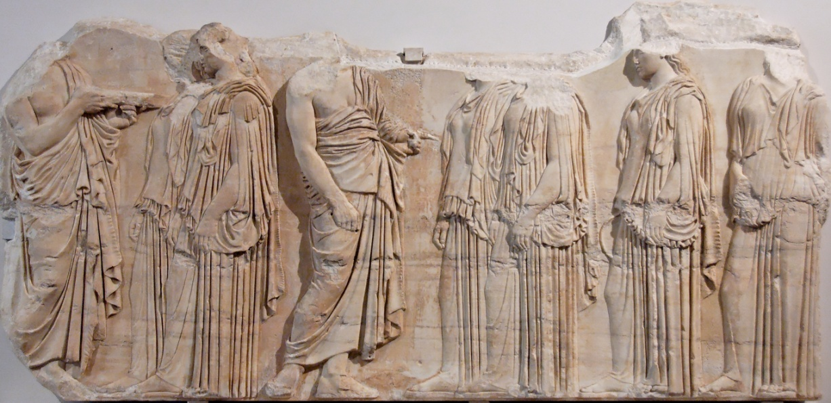
Title (Arial, 44, Bold)
First Author Name (Arial, 24, Bold), Affiliation (Arial, 24, Regular) | Second Author Name, Affiliation | Third Author Name, Affiliation
Heading (Arial, 32, Bold)
Title of the figure (Arial, 20, Bold)
Body Text (Arial, 24, Regular) text text text text text text text text text text text text text text text text text text text text text text text text text text text text text text text text text text text text text text text text text text text text text text text text text text text text text text
text text text text text text text text text text text text text text text text text text text text text text text text text text text text text text text text text text text text text text text text text text text text
text text text text text text text text text text text text text text text text text text text text text text text text text text text text text text text text text text text text text text text text text text text text text text text text text text text text

